Slide 1
Robot Configuration
Servo Origin Position

Slide 2
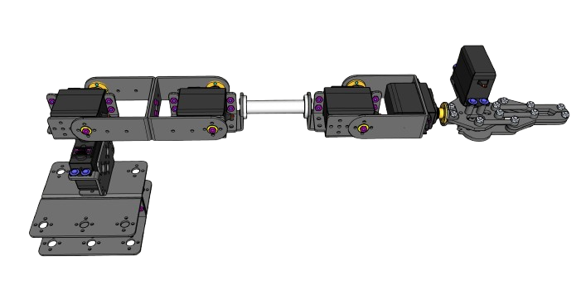
X-Servo
Servo Position = 0

Slide 3
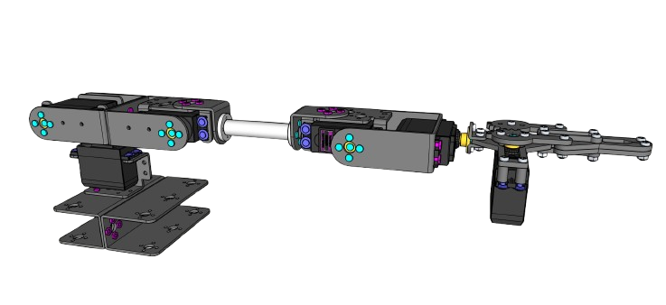
Y-Servo
Servo Position = 0

Slide 4
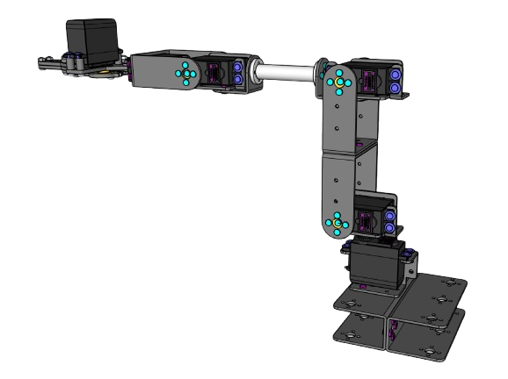
Z1-Servo
Servo Position = 0

Slide 5
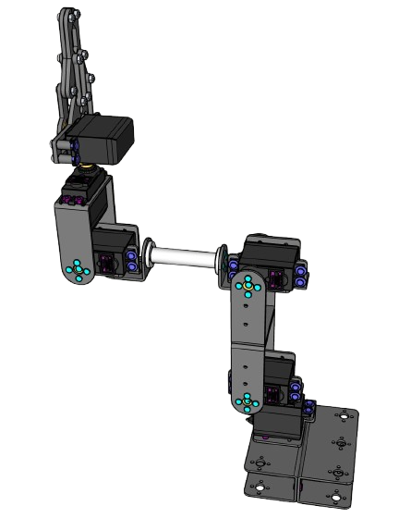
Z2-Servo
Servo Position = 0

Slide 6
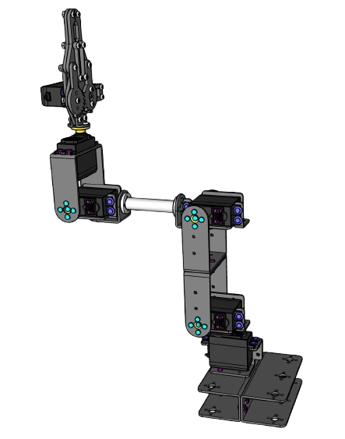
Rotate-Servo
Servo Position = 0

Slide 7
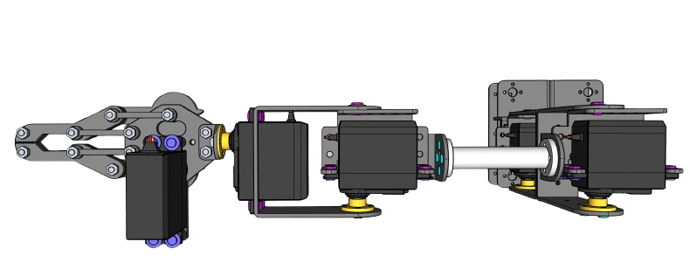
Grip-Servo
Servo Position = 200

